Slide 1
iPad Appy Hour
Session 2
With Bob and Lori

Slide 2
Agenda
Ice Breaker
Adding a website shortcut to your home screen
Talking Pictures app
Stop-motion Animation app
View your websites
Get Students to Interact with your site (cont’d.)
Website maintenance
Closing Activity

Slide 3
Ice Breaker
Sushi Scramble
This game is for 2-4 people, BUT we just want you to play with a partner today.
One of you grab an iPad from the front table.
Find the Sushi Scramble App and play.
Collect letters from the circling sushi boats, and build words to serve hungry sushi-eaters and score points.

Slide 4
Why use Sushi Scramble in the classroom?:
Cooperative or competitive practice forming words from random groups of letter tiles
Multiple players can use the same iPad at the same time.
Players can apply phonics and spelling skills
Read about all 9 SylvanPlay free Educational apps here.

Slide 5
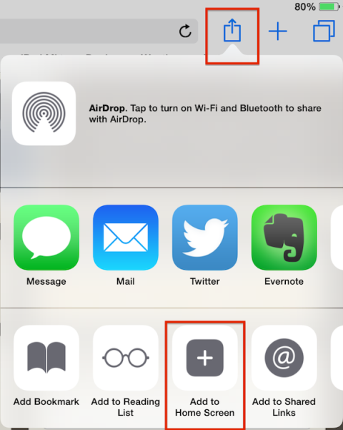
Add a Website Shortcut to Your Home Screen (aka Web Clip)
Using Safari, go to the website you are going to use. In this case, www.arkive.org
In the upper right hand corner, click on the share button
Click on the Add to Home Screen button

Slide 6
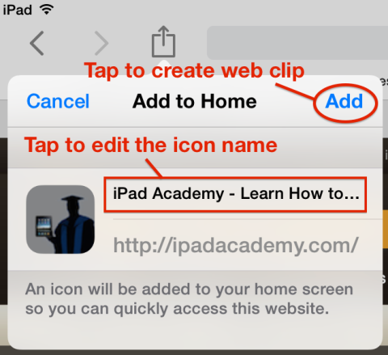
Add a Website Shortcut to Your Home Screen (continued)
Tap to edit the icon name.
Tap Add to create the Web Clip.

Slide 7
Stop-Motion Animation app
Lego Movie Maker
Uses stop-motion animation to let aspiring filmmakers of all ages create their own movies
Simple enough for young kids to enjoy
Capable enough to meet the expectations of older kids.
Allows user to capture images, add titles, dialog, or even sound effects and photo filters
Makes all necessary actions incredibly easy, while keeping advanced capabilities just a tap away

Slide 8
Ways to use Lego Movie Maker in the Classroom:
Social Studies
Math
Create “living” dioramas, no more shoe boxes!
Create “living” maps which can depict anything from population movements to changing war boundaries.
Illustrate a math equation

Slide 9
Ways to use Lego Movie Maker in the classroom:
Reading:
Science
Chose a chapter or scene from a book or story the students are reading to re-create.
Ask students to recreate the climax of a story.
Give students a vocabulary word- have them create a scene that describes the word without using the actual word in the movie – other students can “guess” the word they used.
Personification- ask students to personify inanimate objects (make scissors walk, make your desk talk, etc.)
If you are growing plants in your room, have the students create a movie by taking a picture of the plant every day. When the movie is complete you will have a movie of the life cycle of the plant. You can also have the students label the different life cycles using the text editor in the application.
Students can create a movie depicting the solar system, including the movements of the planets and moons.
Any “building” activity can be recorded using the application such as work with K-Nex kits.

Slide 10
Talking Pictures App
ChatterPix
Snap picture with your iPad or import a picture from your iPad’s camera roll.
Draw in a mouth and tap the record button to make your picture talk. Your recording can be up to thirty seconds in length.
Before publishing your talking picture you can add fun stickers, text, and frames to your picture.
Finished Chatter Pix projects are saved to your camera roll and from there you can export it to a number of services including YouTube.

Slide 11
Chatterpix cont’d.
Tutorial
Examples
BASIC:
John Adams Coin
Sea Animal Facts
Rectangle
Book Response
Thanksgiving Jokes
Famous Americans Project
Amendment
ADVANCED:
Try App Stacking or App Mashing using Doodle Buddy, ChatterPix, and iMovie

Slide 12
Get Students to Interact with your Website
Sign up for Bravenet
Sign up for Padlet
(*formerly known as Wallwisher)

Slide 13
Padlet
How-To Video:
Key features and much more:

Slide 14
Padlet continued
32 Interesting Ways to Use Padlet in the Classroom
Classroom 21
20 Useful Ways to Use Padlet in Class Now

Slide 15
Bravenet Guestbook
Can be used in many of the same ways as Padlet
Easier to set up and manage?

Slide 16
How to Add a Script Window
Video tutorial

Slide 17
Let’s take a peek at your websites:
Bring your website up on your desktop.
Tour the room, looking at your colleagues’ work.

Slide 18
Closing Activity
Bluster
Partner Up
Only 1 iPad per pair is needed
Find the “Bluster” app
Read the “How to Play” section
Click on “Play”
Choose “Versus”, pick a level & category
Have fun!

Slide 19
Why use Bluster in the classroom?
Students can learn to work cooperatively playing in Team mode or competitively playing in Versus mode.
3 levels of play challenge learners at a wide range of levels,
The iPad screen works beautifully as a fun table-top game.
Kids can learn to recognize rhyming words, homophones, synonyms, adjectives, prefixes, and suffixes.
Students will strengthen vocabulary skills through exposure to 800 words

